Slide 1
Detección de factores de riesgo asociados al deterioro clínico en pacientes con COVID-19
Dra. Laura Elizabeth Sandoval Mosqueda
Dirección de Prestaciones Médicas
HGZ 48 IMSS
Coordinación de Atención Integral en Segundo Nivel

Slide 2
Introducción
Diciembre 2019, Wuhan, China
Neumonía de etiología desconocida.
Enero 7, 2020
Severe acute respiratory syndrome coronavirus 2 (SARS-CoV-2)
Coronavirus disease 2019 (COVID-19)
Febrero 2020, OMS
Lancet 2020; 395: 1054–62
Notes:
In December, 2019, Wuhan city, the capital of Hubei
province in China, became the centre of an outbreak of
pneumonia of unknown cause. By Jan 7, 2020, Chinese
scientists had isolated a novel coronavirus, severe acute
respiratory syndrome coronavirus 2 (SARS-CoV-2; previously
known as 2019-nCoV), from these patients with
virus-infected pneumonia,1,2 which was later designated
coronavirus disease 2019 (COVID-19) in February, 2020,
by WHO.
Although the outbreak is likely to have started from a
zoonotic transmission event associated with a large
seafood market that also traded in live wild animals, it
soon became clear that efficient person-to-person transmission
was also occurring

Slide 3
Introducción
Amplio espectro clínico en infección por SARS-CoV-2
Infección asintomática
Enfermedad leve del tracto superior
Neumonía viral grave
Falla respiratoria
Muerte
Lancet 2020; 395: 1054–62
Notes:
The clinical spectrum of
SARS-CoV-2 infection appears to be wide, encompassing
asymptomatic infection, mild upper respiratory tract
illness, and severe viral pneumonia with respiratory
failure and even death, with many patients being
hospitalised with pneumonia in Wuhan

Slide 4
Lo que nos interesa…
Estimación de factores de riesgo:
Predictores
Enfermedad
grave
Muerte
Lancet 2020; 395: 1054–62

Slide 5
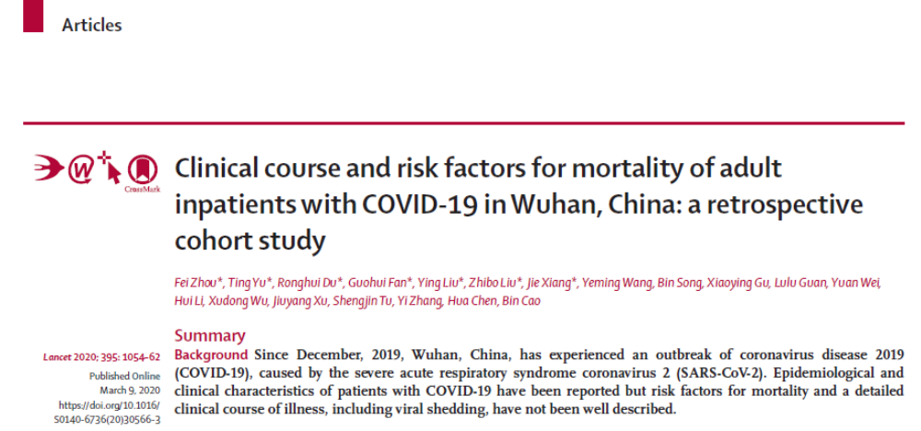

Slide 6
Resultados
Tiempo medio desde el inicio de la enfermedad hasta:
Egreso hospitalario - 22 días -
Muerte - 18 días -
Ventilación mecánica - 14 días -
97% de los pacientes que requirieron ventilación mecánica fallecieron
Notes:
The median time from illness onset (ie, before admission)
to discharge was 22・0 days (IQR 18・0–25・0), whereas the
median time to death was 18・5 days (15・0–22・0; table 2).
32 patients required invasive mechanical ventilation, of
whom 31 (97%) died. The median time from illness onset to
invasive mechanical ventilation was 14・5 days (12・0–19・0).
Extracorporeal membrane oxygenation was used in three
patients, none of whom survived. Sepsis was the most
frequently observed complication, followed by respiratory
failure, ARDS, heart failure, and septic shock (table 2). Half
of non-survivors experienced a secondary infection, and
ventilator-associated pneumonia occurred in ten (31%) of
32 patients requiring invasive mechanical ventilation. The
frequency of complications were higher in non-survivors
than survivors

Slide 7
Resultados
Complicaciones
Sepsis
Falla respiratoria
SDRA
Falla cardiaca
Choque séptico

Slide 8
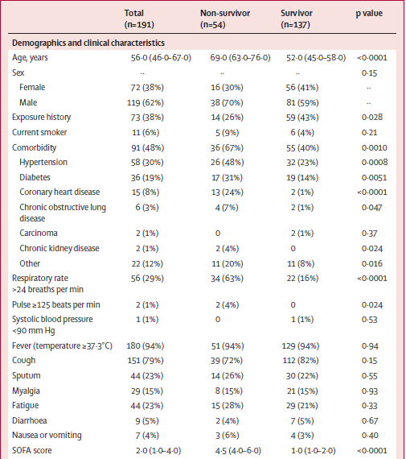

Slide 9
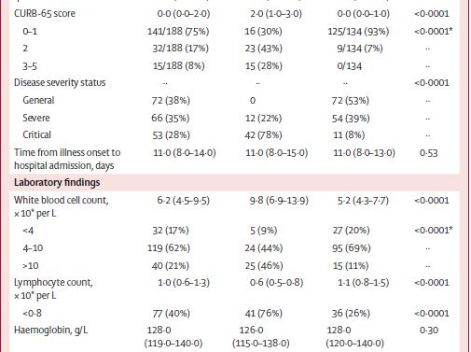

Slide 10
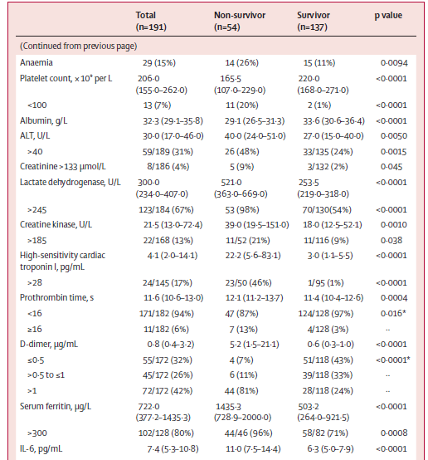

Slide 11
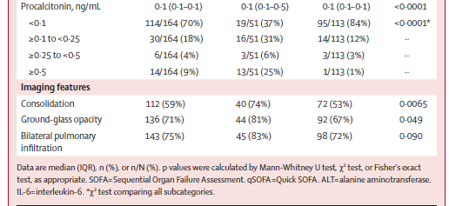

Slide 12
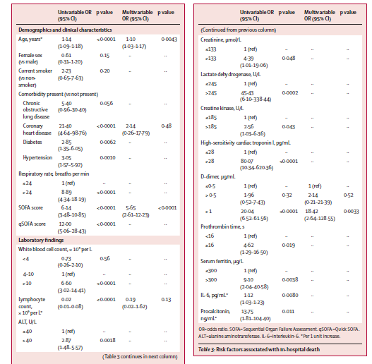

Slide 13
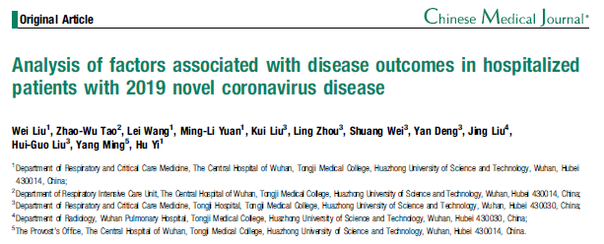

Slide 14
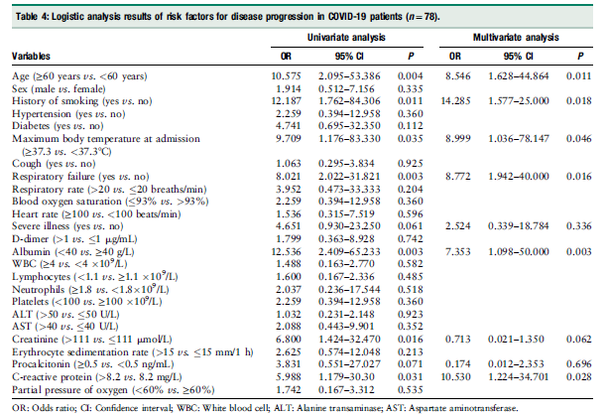

Slide 15
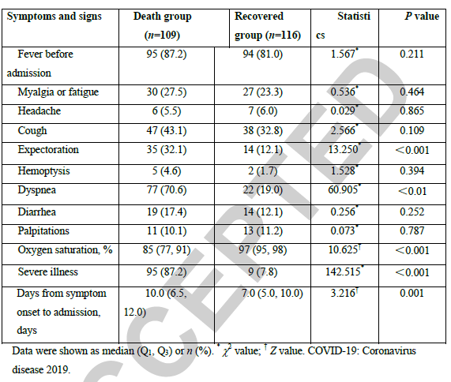
No olvidar los principios básicos de la práctica clínica

Slide 16
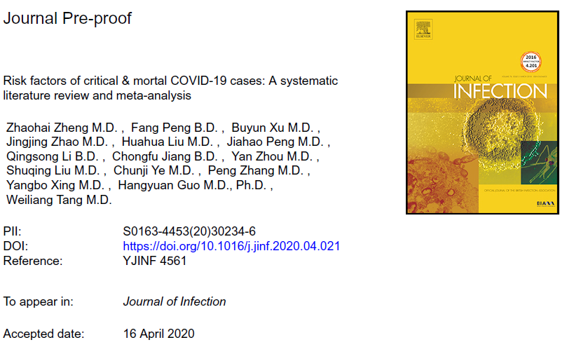
¿Dónde estamos?

Slide 17
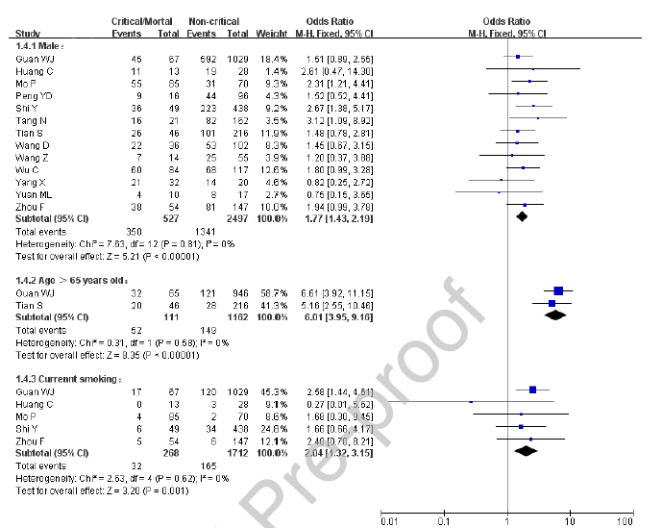

Slide 18
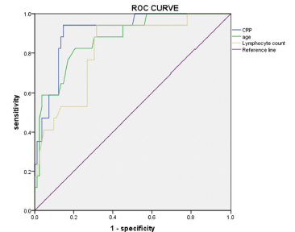
¿Dónde estamos?
INFECTIOUS DISEASES, 2020; VOL. 0, NO. 0, 1–8
Notes:
ROC curve of independent risk factors for disease progression
in patients with COVID-19.

Slide 19

¿Hacia dónde vamos?
Índices predictivos

Slide 20
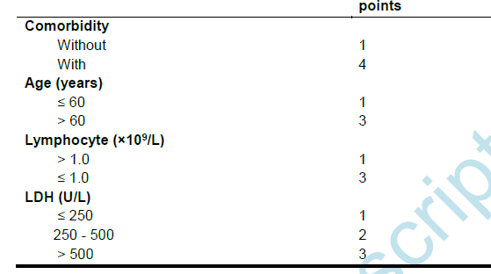
Índice predictivo CALL
VPP 50.7% / VPN 98.5%
4-6 puntos <10% progresión Riesgo Bajo / Clase A
7-9 puntos 10-40% progresión Riesgo intermedio / Clase B
10-13 puntos 50% progresión Riesgo Alto Clase C

Slide 21
Conclusiones
Anticipación de complicaciones
Toma de decisiones
Implementación de estrategias diagnóstico – terapéuticas
Optimización de recursos médicos
Incremento del efecto terapéutico
Reducción de mortalidad

Slide 22
Contacto:
Correo:
layura16@hotmail.com

